Slide 1
MongoDB
Sharan prakash babu
Iit chicago

Slide 2
What is MongoDB?
MongoDB (from “humoungus”) is a scalable, high-performance, open source, schema-free, document-oriented database. - mongodb.org

Slide 3
Philosophy
“One size fits all” approach no longer applies
Non-Relational DB’s scale more easily, especially horizontally
Focus on speed, performance, flexibility and scalability
Not concerned with transactional stuff and relational semantics
DBs should be an on-demand commodity, in a cloud- like fashion

Slide 4
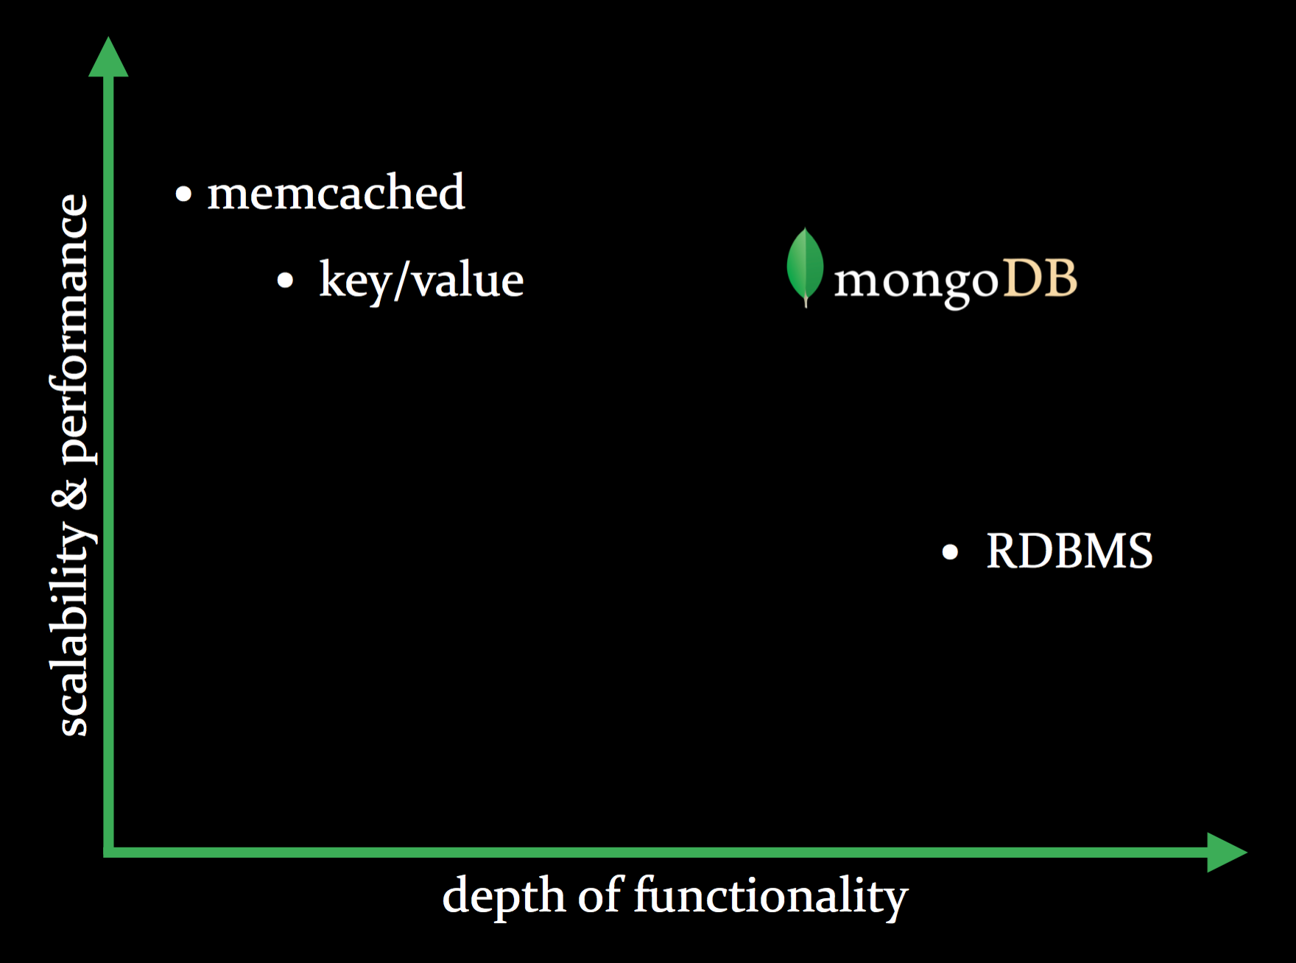
Philosophy
Mongo tries to achieve the performance of traditional key-value stores while maintaining functionality of traditional RDBMS

Slide 5
Features of MongoDB
Document data model
Documents are stored in BSON (binary JSON)
BSON is a binary serialization of JSON-like objects
This is extremely powerful, b/c it means mongo understands JSON natively
Any valid JSON can be easily imported and queried
Sample JSON
{“author”: “sharan”, “text”: “...”}
{“author”: “eliot”, “text”: “...”, “tags”: [“mongodb”]}
JSON style Document represented in BSON
{“hello”: “world”}
\x16\x00\x00\x00\x02hello \x00\x06\x00\x00\x00world \x00\x00

Slide 6
Features of MongoDB (contd.)
Dynamic Schema
Polymorphic Data is the normal
Data models can evolve as the applications evolve – quicker to iterate
Highly flexible
Sample “Schemas” ( Document )
{“author”: “mike”,
“text”: “...”}
{“author”: “eliot”,
“text”: “...”,
“tags”: [“mongodb”]}

Slide 7
Features of MongoDB (contd.)
Built-in Horizontal Scalability
Low infrastructure costs – commodity hosts
Elasticity – start small and invest incrementally
Strong with major languages
Supports Map-Reduce
Querying
Rich, JavaScript-based query syntax A
Allows us to do deep, nested queries
Ex. db.order.find( { shipping: { carrier: ”SpeedPost" } } );

Slide 8
Concepts
Document Oriented
Think of “documents” as database records
Documents are basically just JSON objects that Mongo stores in binary
Think of “collections” as database tables
RDBMS (mysql, postgres) | MongoDB
Tables | Collections
Records/rows | Documents/objects
Queries return record(s) | Queries return a cursor

Slide 9
Concepts(contd.)
Cursors
Queries return “cursors” instead of collections
A cursor allows you to iterate through the result set
A big reason for this is performance
Much more efficient than loading all objects into memory
Capped collections
Fixed-sized, limited operation, auto-LRU age-out collections
Fixed insertion order
Super fast
Ideal for logging and caching

Slide 10
Uses
Scaling Out
Caching
The Web
High Volume
Data Warehousing

Slide 11
What MongoDB does not support?
Joins
Highly Transactions
Problems that require SQL
Relational Integrity

Slide 12
Demo
Demo of the following operations
Creating a collection
Inserting documents
Finding documents
How a key values pair works

